Slide 1
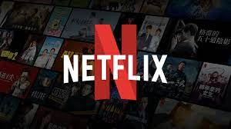
Story About
Successes and failures
Projects
In Software Developments
- Case Study

Slide 2
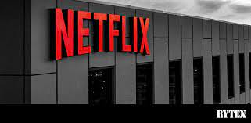
Successes story of Netflix
Introduction :
Netflix is a subscription-based streaming service that allows people to watch TV shows and movies on an internet-connected device. Depending on people’s plan, They can also download TV shows and movies to There iOS, Android, or Windows 10 device and watch without an internet connection

Slide 3
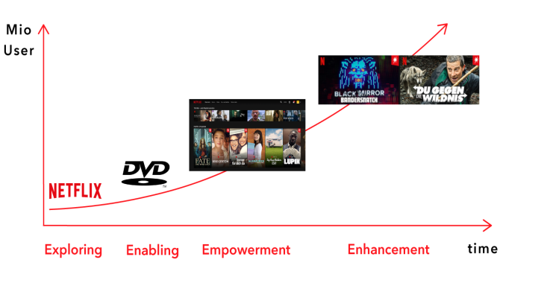
Reason of Successes in Netflix Software development
Creating Disruption through Technology
Flexibility
Variety of Options
Strategy of Original Content
Ad-Free Content
Enhanced User Experience
Personalized experience through Netflix recommendation
engine

Slide 4
Creating Disruption through Technology :
Netflix is making moves throughout the years to expand its
audience base at a continual pace.
Netflix was just shipping DVDs through the mail and later they eliminated late fees that greatly lead to Blockbuster’s crush.
2. Flexibility :
The biggest advantage Netflix is giving to its customers that they can watch any content with convenience.
Netflix is making sure to give smooth experiences with personalized tastes.

Slide 5
3. Variety of Options :
Subscribers of Netflix are given options to have a range of movies, TV series, and documentaries by distribution partners.
This opens new options on a regular basis attracting millions of customers.
4. Strategy of Original Content :
As per the source of Variety, Netflix is planned to spend billions on the content .
This is the reason that Netflix is topping in the customer-satisfaction surveys.

Slide 6
5. Ad-Free Content :
people get irritated with ads coming in between their favorite program time so Netflix offers ad-free content.
This prevents users from annoying and irrelevant ads making sure to give ad-free experience to all its customers.
6. Enhanced User Experience :
Netflix does all research to come up with the best user experience.
It also facilitates to share your Netflix account and gives 30 days free subscription.

Slide 7
7. Personalized experience through Netflix
recommendation engine :
Netflix knows what we watch on this platform every day.
Netflix efficiently uses machine learning in order to help their algorithms learn.
Conclusion
With all the great and overwhelming features, Netflix is marked as successful as it prioritizes subscribers’ needs. The regular transformation is bringing innovations and creating ease for all its subscribers. The success story of Netflix is their business strategy to make customers glued to this platform

Slide 8
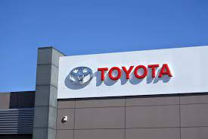
Failure story of Toyota’s software
Introduction :
Toyota System into a software development process, we can come up with a series of key areas or steps where it's possible to avoid waste, and thus create products that accomplish the goals of the client, the team, and the project in the least wasteful way possible.

Slide 9
Reason of Failure in Toyota Software development
Recalls of over 1.9 million Toyota Prius hybrid cars in 2013
due to software glitch.
Recall of around 400,000 cars in 2010 due to software bug
causing engine to stall.
Recall of around 6.5 million vehicles in 2015 due to defect
in power window switch .
Below average ranking of Toyota's navigation system .
These instances result in customer dissatisfaction, recalls
and potential safety concerns
Importance of testing and validating software
development processes to avoid failures.

Slide 10
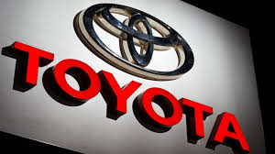
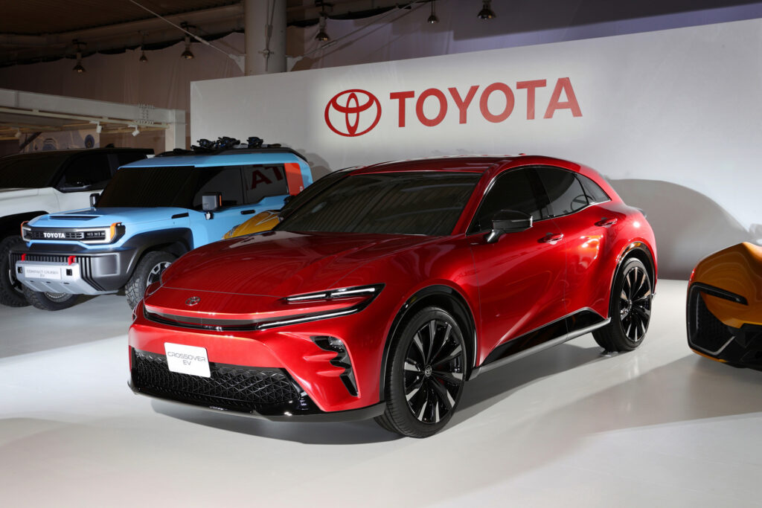

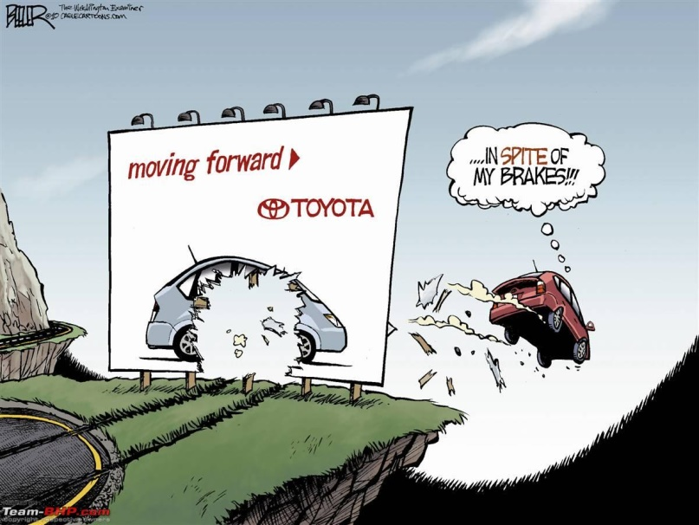

Slide 11
Recalls of over 1.9 million Toyota Prius hybrid cars in 2013 due to software glitch :
In 2013, Toyota recalled over 1.9 million Toyota Prius hybrid cars due to a software glitch that caused the car's hybrid system to shut down unexpectedly while driving, which could cause the car to stall and potentially lead to accidents or injuries.
2. Recall of around 400,000 cars in 2010 due to
software bug causing engine to stall :
In 2010, Toyota issued a recall of around 400,000 cars due to a software bug that caused the engine to stall, which again could potentially lead to accidents or injuries. This recall affected some Lexus and Crown models.

Slide 12
Recall of around 6.5 million vehicles in 2015
due to defect in power window switch :
In 2015, Toyota announced a recall of around 6.5 million vehicles due to a defect in the power window switch, which could potentially cause a fire. This wasn't specifically a software bug, but rather a problem with the component itself.
4. Below average ranking of Toyota's navigation
system :
Toyota's navigation system has been criticized for being below average in comparison to other vehicles. This has led to customer dissatisfaction, as they expect better features and functionality from the system.

Slide 13
5. These instances result in customer dissatisfaction,
recalls and potential safety concerns :
Toyota's software development failures, such as the defects and glitches in their cars' software and the problems with the navigation system, resulted in customer dissatisfaction, recalls, and potential safety concerns.
Importance of testing and validating software development processes to avoid failures :
If Toyota had invested more time and resources in testing and validating their software development processes, they could have potentially avoided these issues. By thoroughly testing and validating the software.

Slide 14
Conclusion
The incidents of Toyota's software development failures serve as a reminder that companies must prioritize testing and validation to minimize the risk of costly and damaging failures. By investing in these processes, companies can improve the quality of their software, reduce the risk of safety concerns, and enhance customer satisfaction, ultimately leading to a positive impact on the company's brand reputation and bottom line.

